Slide 1
Next Up:
David Sass & Björn Sundling

Slide 2
3
3

Slide 3
2

Slide 4
1

Slide 5
VS Code Extension Deployment with Intune
David Sass & Björn Sundling

Slide 6

Many thanks to our sponsors:
Notes:
Check that this is the latest in the master template

Slide 7


<- Björn David ->
<- Likes DevOps
<- Likes fishing. The boat version, not the stealing password version..
<- Consultant @ Knowledge factory, Advania.
Likes Intune ->
Likes camping. The tent version, not the game version.. ->
Security Domain Architect @ switch.ch ->

Slide 8
Why this session
Supply chain risk
Dev & SysAdmin folks are high risk and targeted
Security over Dev experience
Dev tool supply chain risk
Dev experience is still important

Slide 9
Supply chain risk
Supply chain risk is when a supplier of yours or a supplier of your supplier gets hacked and through their compromise your business gets compromised too.
It’s bad when it happens to your supply chain.
It’s worse when you are that supplier which gets hacked first.
This usually gets you on the news.

Slide 10
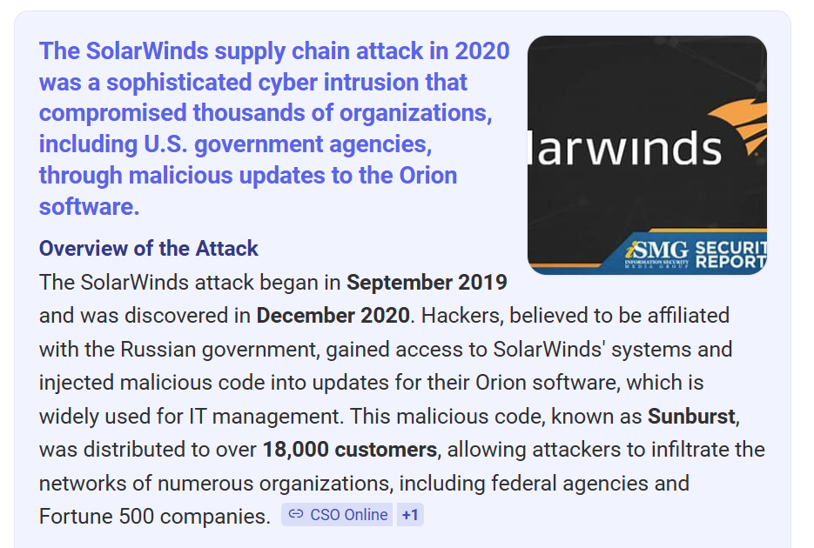
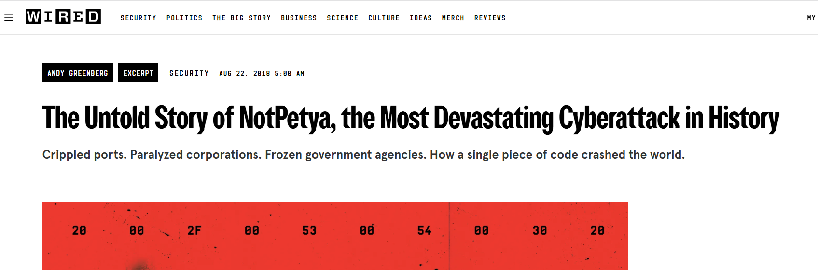
Notable supply chain incidents
NotPetya 2018
SolarWinds 2020

Slide 11

Why is this relevant to us?

Slide 12

We are high risk and being targeted
Our role makes us targeted
Most times we have access to sensitive content
We usually want or require local admin access
We want cool tools (and aren’t afraid to install them)
Our security is systematically treated as unimportant.

Slide 13
Our security is systematically treated as unimportant.

Slide 14

Isn’t that right?

Slide 15
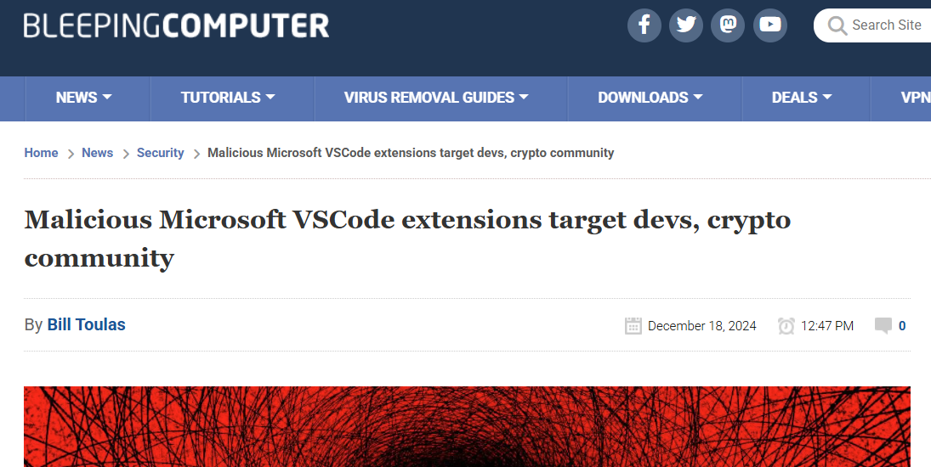
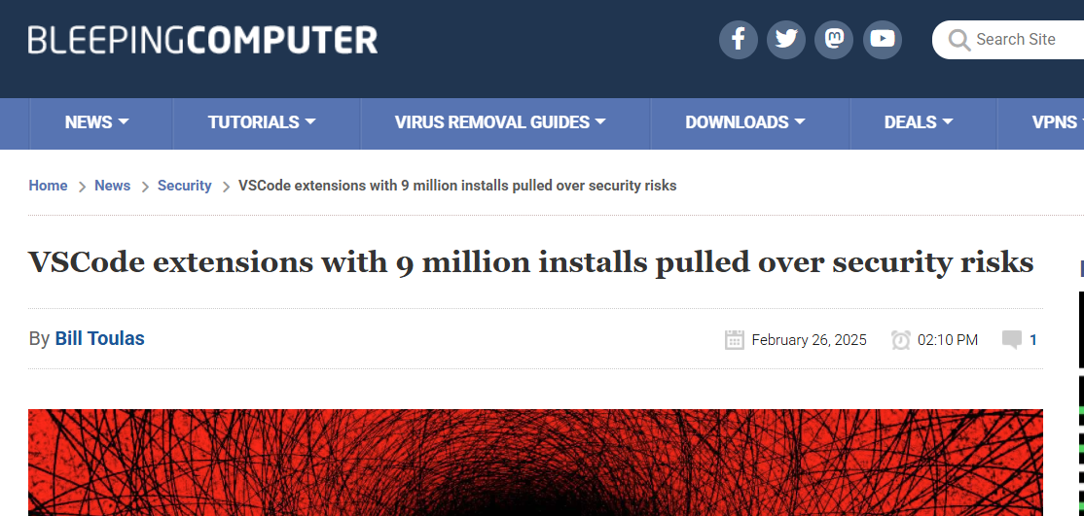
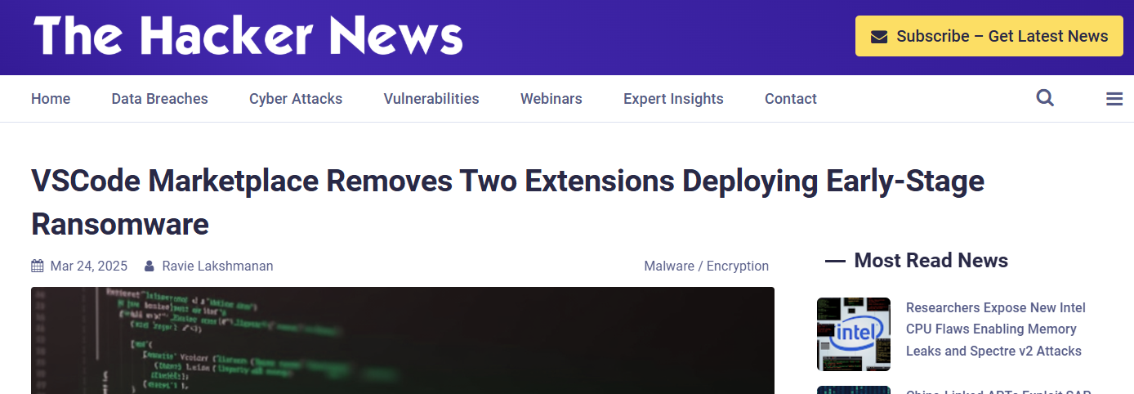
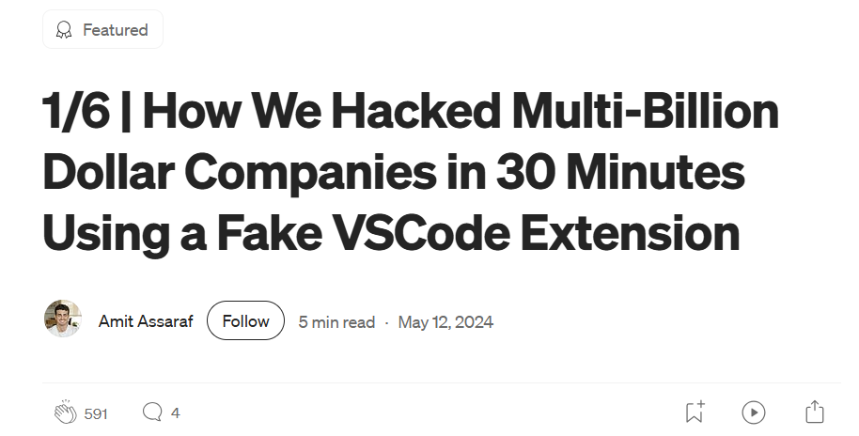
Dev tool supply chain risk
That’s also serious enough to make the news.
Solarwinds attack was carried out by hacking the CI/CD tool which was producing the installerts.

Slide 16
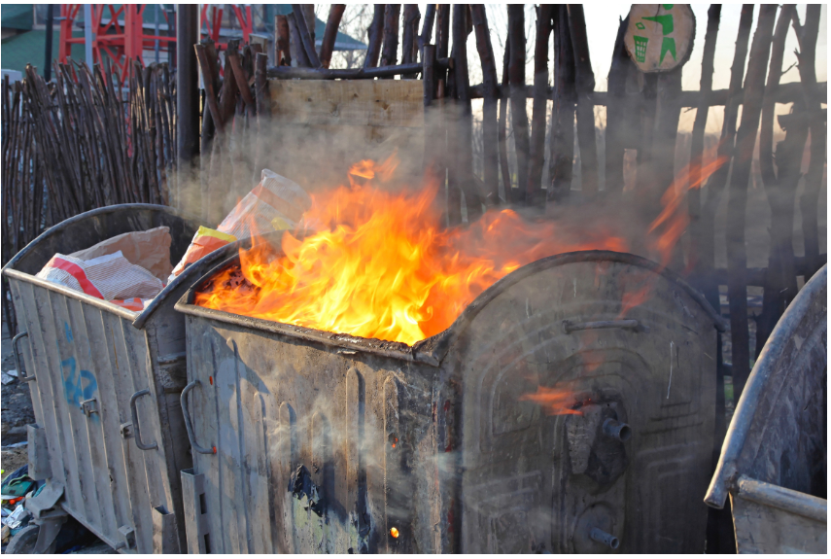
It’s not all bad

Slide 17
This is where this session comes in
We shouldn’t be part of the problem
Security doesn’t have to suck (the joy out of our lives)
We are creative people, right?
Let’s help fix the problem!

Slide 18
Goal
Curated list of trusted & validated extensions
Vetting of extensions, security scanning, etc.
Self-service installation
Integrate with existing management capabilities
Better security through DevOps

Slide 19
Where can we start?
Software and patches usually done with?
Intune
How is that usually gets done?
Automation
What are we good at?
Both

Slide 20

Intune?
Request new extensions?
Download the extension package(s)
Store them somewhere.. A blob maybe?

Slide 21
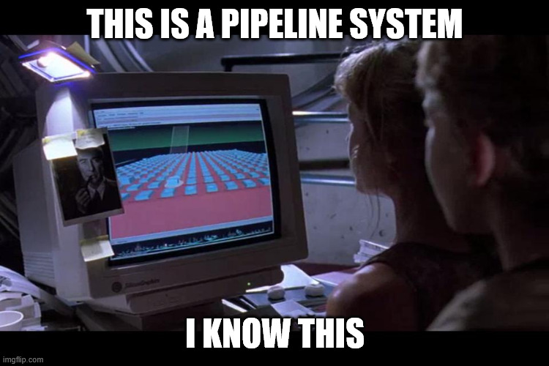
Getting packages from A to B!
Intune?
Downloading extensions - Does the store even have an API?
Integrity of my extension packages?
Security? – We don’t want no viruses..
Hey David… Where do you want your extensions?

Slide 22
Demos
The GitHub stuff!

Slide 23
Good DevEx
Bundle of extensions
Pull instead of push
Self-service

Slide 24
Demos
Intune

Slide 25
Still not in place…
Bundle of extensions
Some security stuff in GitHub
(And caching.. Caching is good)
Blob setup bicep.. Setting up Blobs are strangely hard 😂
Better way to request extensions.
Notes:
Virus scan, etc.
ExtensionTotal | Supply Chain Gateway for Software Marketplaces

Slide 26
Q&A
15 minutes

